Slide 1

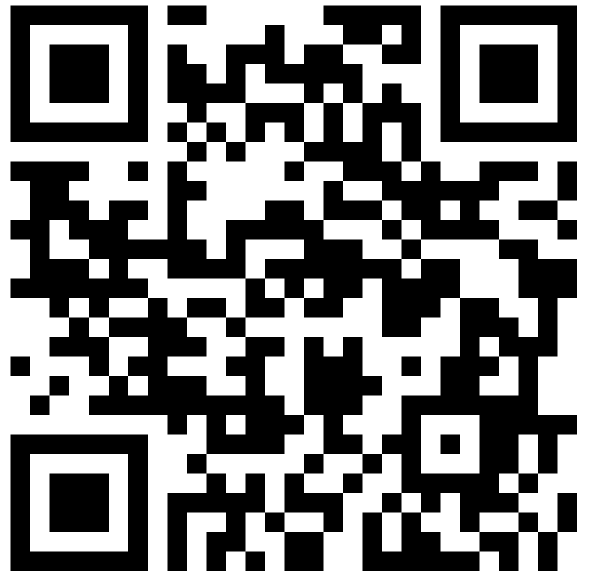
Kinematics
COMSM4111 Robotic Systems
Anonymous Feedback form:
https://forms.gle/PyQQy2mwzyATFmJW6
Padlet board (questions & comments):
http://padlet.com/paul_odowd1/1lhoodwv2fuc
Delivered by:
Paul O’Dowd paul.odowd@bristol.ac.uk

Slide 2
House Keeping
Drop-In Session – Tuesday 22nd October, 5pm MVB?

Slide 3
Lab Sessions / Sheets
Week 1
Week 2
Week 3
Week 4
Week 5
Week 6
Week 7
Meet the Romi
Millis()
Encoders
PID
Line Following
Finite State Machine
Motors
Time & Speed
Kinematics
Lectures
Intro
Sensors & Actuators
Feedback Control 2
Probabilistic Robotics
System
Architectures
Path Planning
Experimental Robotics
Micro-controllers
Feedback Control 1
Kinematics
PID Drop-In
Sensor Fusion
Searching & Mapping
Toward
Assessment 2
Assessment Op 1
Assessment Op 2
Assessment Op 3

Slide 4
This Lecture
Kinematic Update
Encoder Resolution
Encoders and Distance
Coordinate Systems
Wheel Contributions
Transforming to Global Reference
Kinematic Model -> Kinematic Update
An Exception (advanced)

Slide 5
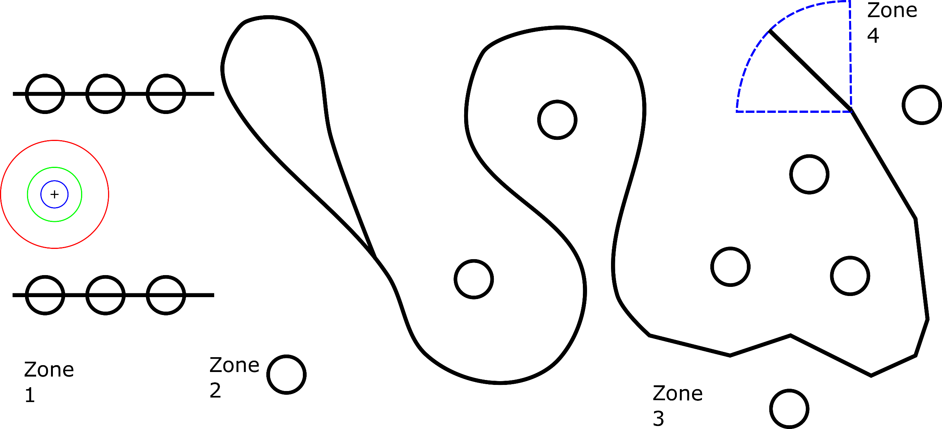
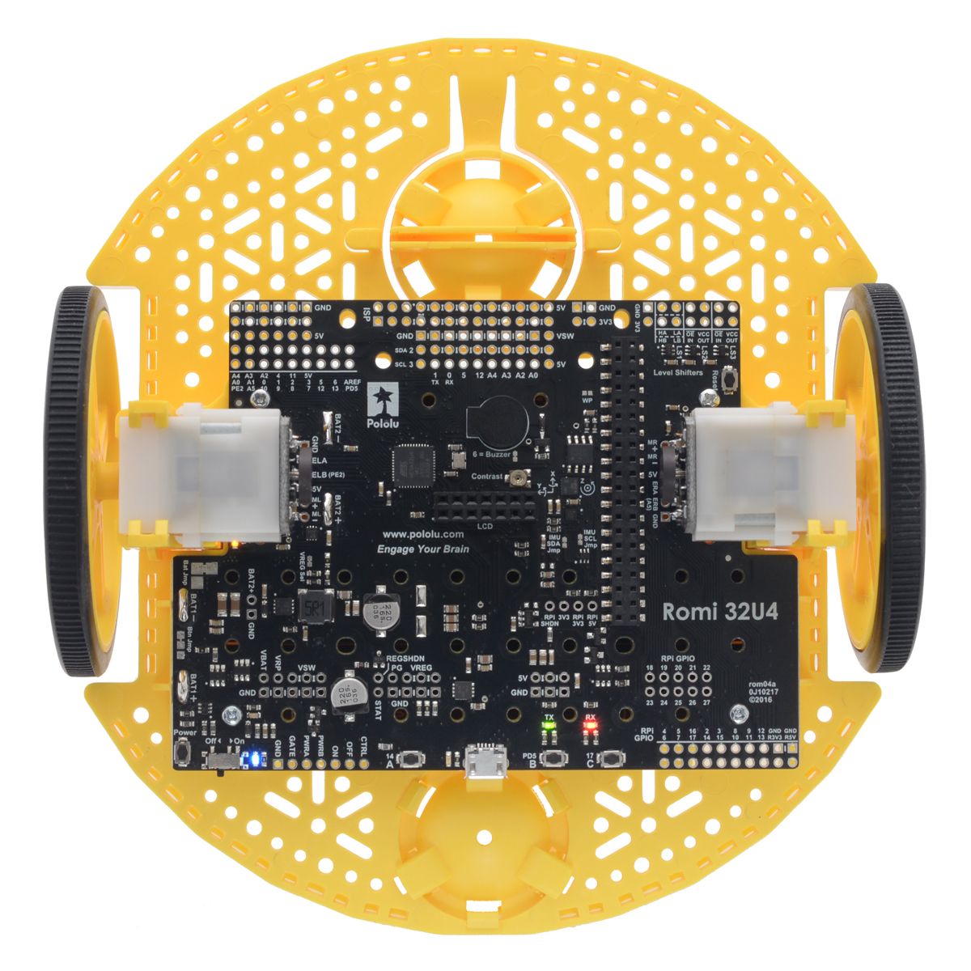
Assessment 1:
Notes:
For coursework 1, your robot will have to follow a line something like this.
Each ‘zone’ of the line challenge presents learning challenges for you.
Each of these challenges is supported with the lab sessions.
We will review this in more detail with the CW1 specification sheet.

Slide 6
Kinematic Update:
At timestep:
X_{I’} = ( X_{R’} * cos(θ_{R}) )
Y_{I’} = ( X_{R’} * sin(θ_{R}) )
θ_{I’} = θ_{R’}
( (Φ_{l} r ) + (Φ_{r} r )
* cos(θ_{R})
X_{I} +=
2
( (Φ_{l} r ) + (Φ_{r} r )
r = radius of wheel
l = wheel distance from centre of Romi
Φ = angular velocity
Y_{I} +=
* sin(θ_{R})
2
(Φ_{l} r ) - (Φ_{r} r )
θ_{I} +=
2l

Slide 7
This Lecture
Kinematic Update
Encoder Resolution
Encoders and Distance
Coordinate Systems
Wheel Contributions
Transforming to Global Reference
Kinematic Model -> Kinematic Update
An Exception (advanced)

Slide 8
Encoder Resolution

Slide 9
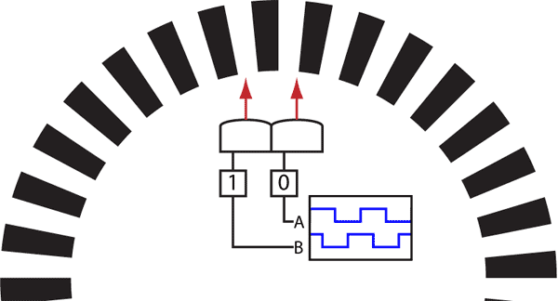
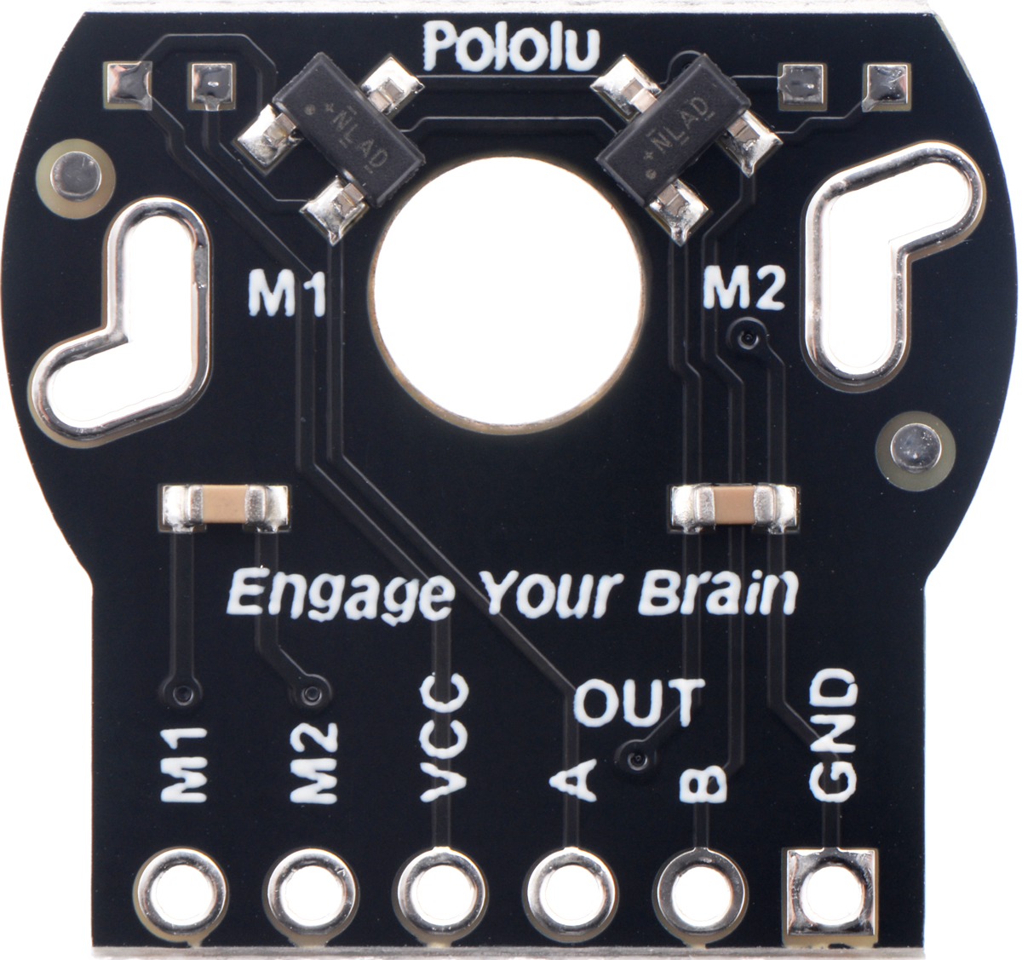
B`
A
12 Counts Per Revolution

Slide 10


Slide 11
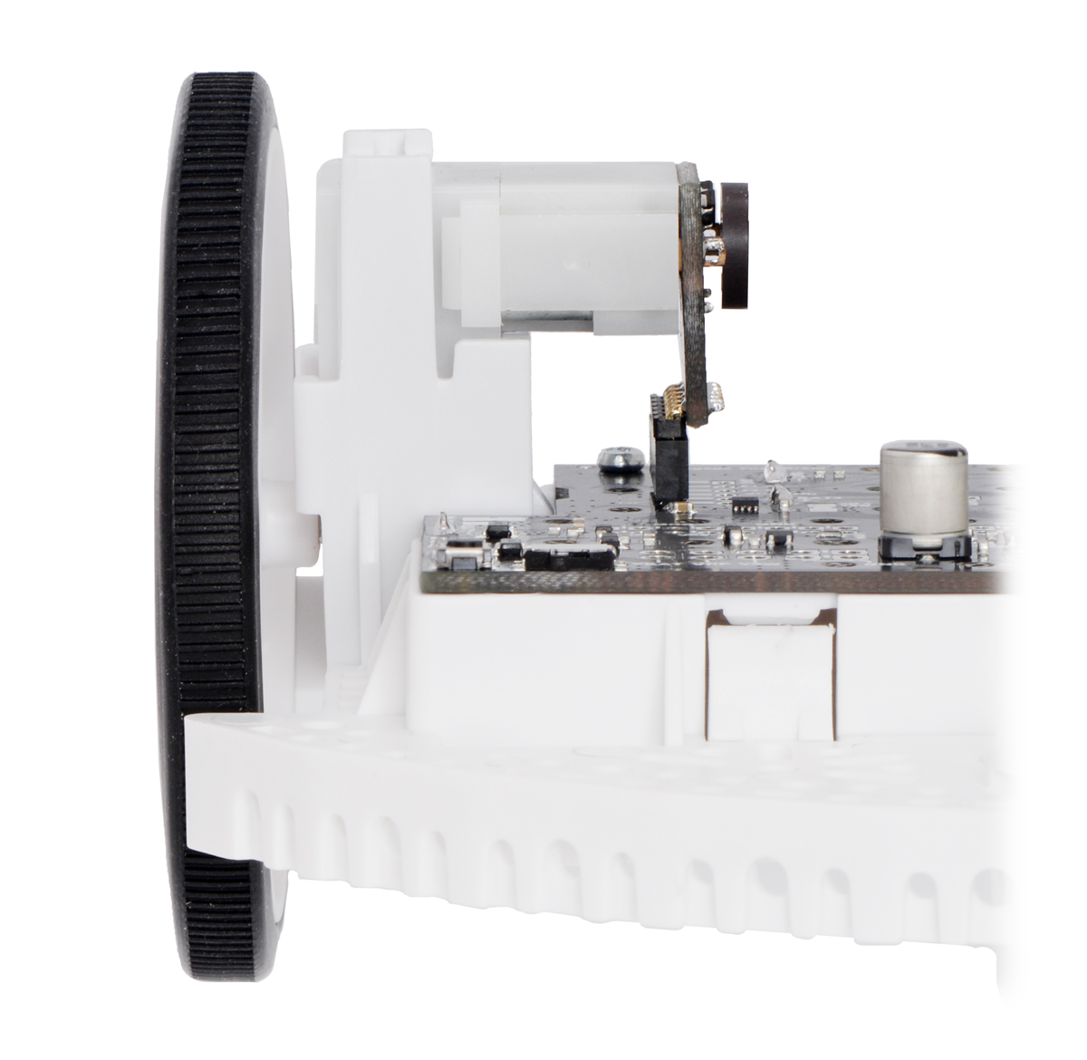
Hall Effect Sensors
DC Motor
1 : 120 Gearbox
Magnet
35mm Radius Wheel

Slide 12
120 Revolutions
12 Counts Per Revolution
1 Revolution

Slide 13
120 Revolutions
*
12 Counts Per Revolution
1 Revolution

Slide 14
120 Revolutions
*
12 Counts Per Revolution
1 Revolution = (120 * 12) Counts
1 Revolution = 1440 Counts
(2 * PI ) = 1440 Counts
Angular Resolution = (2*PI) / 1440
Angular Resolution = 0.0043 (0.24 degrees)

Slide 15
(360 degrees)
120 Revolutions
*
12 Counts Per Revolution
1 Revolution = (120 * 12) Counts
1 Revolution = 1440 Counts
(2 * PI ) = 1440 Counts
Angular Resolution = (2*PI) / 1440
Angular Resolution = 0.0043 (0.24 degrees)
1 count = 0.0043 radians.

Slide 16
120 Revolutions
*
12 Counts Per Revolution
1 Revolution = (120 * 12) Counts
1 Revolution = 1440 Counts
(2 * PI ) = 1440 Counts
Angular Resolution = (2*PI) / 1440
Angular Resolution = 0.0043 (0.24 degrees)
1 count = 0.0043 radians.
Wheel Radius = 35mm
1 count = 35 * 0.0043
1 count = 0.15mm

Slide 17
This Lecture
Kinematic Update
Encoder Resolution
Encoders and Distance
Coordinate Systems
Wheel Contributions
Transforming to Global Reference
Kinematic Model -> Kinematic Update
An Exception (advanced)

Slide 18
Encoders and Distance

Slide 19
Number of Counts = Distance

Slide 20
Number of Counts = Distance
Circumference of Circle = 2 * PI * r
2 * PI * 35mm
Circumference of Wheel = 219.91mm

Slide 21
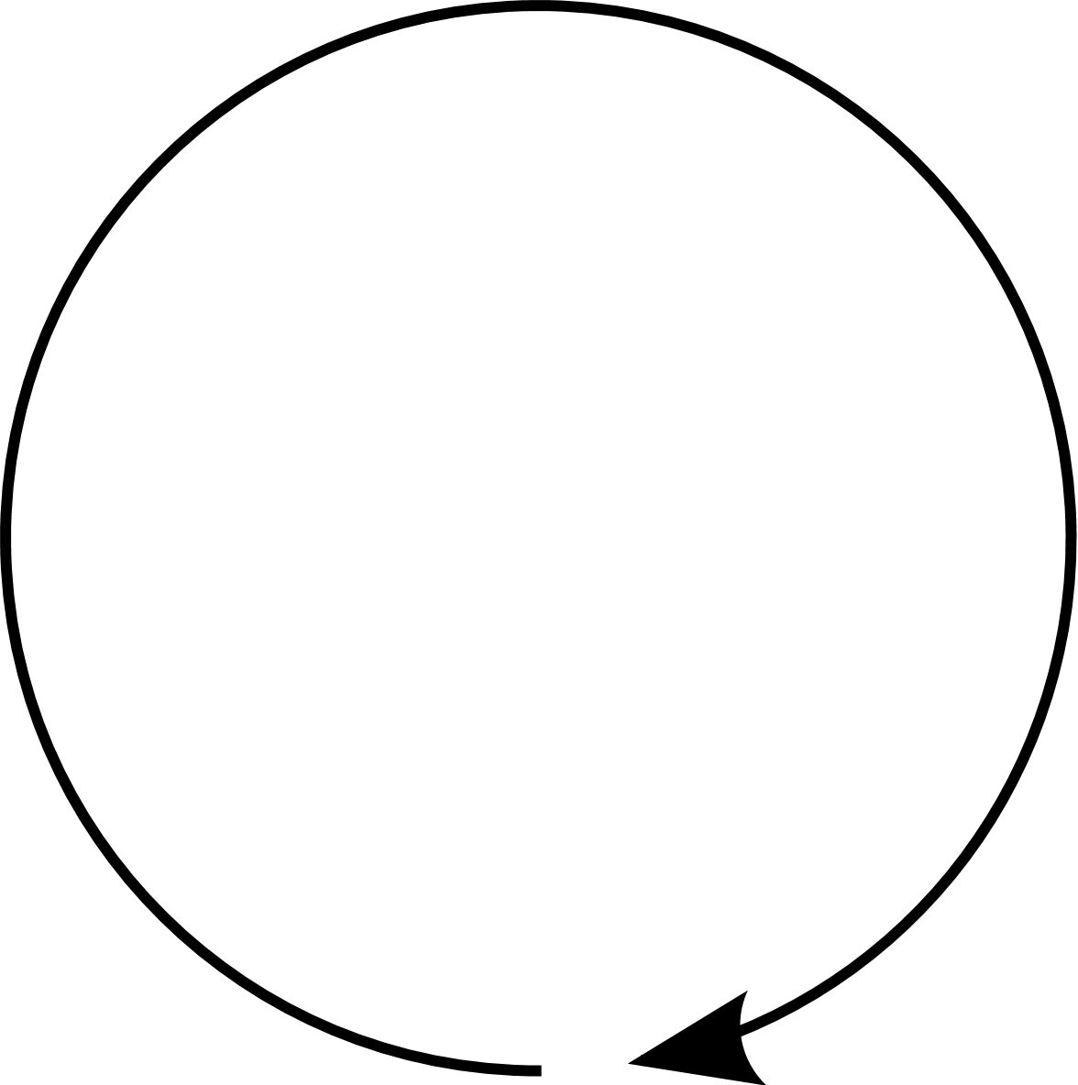
Number of Counts = Distance
Circumference of Circle = 2 * PI * r
2 * PI * 35mm
Circumference of Wheel = 219.91mm
= 1440 counts = 219.91mm

Slide 22
Number of Counts = Distance
Circumference of Circle = 2 * PI * r
2 * PI * 35mm
Circumference of Wheel = 219.91mm
= 1440 counts = 219.91mm
1 count = 219.91mm / 1440
1 count = 0.15mm

Slide 23
This Lecture
Kinematic Update
Encoder Resolution
Encoders and Distance
Coordinate Systems
Wheel Contributions
Transforming to Global Reference
Kinematic Model -> Kinematic Update
An Exception (advanced)

Slide 24
Coordinate Systems

Slide 25
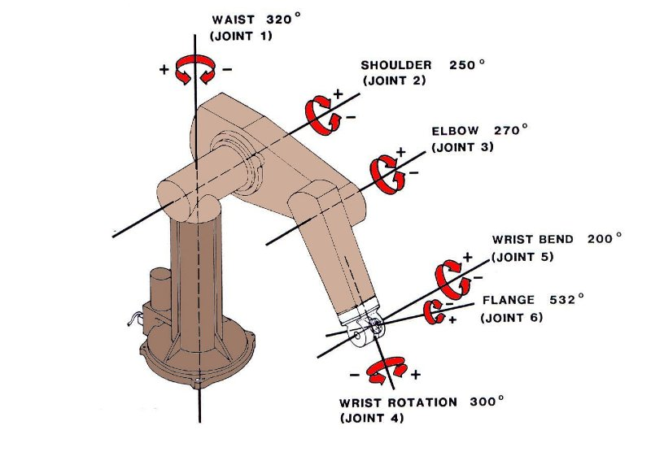
Absolute Coordinate System
Notes:
What can we determine from these sensors?
Image source:
http://rutherford-robotics.com/PUMA/images/PUMA_limits.JPG

Slide 26
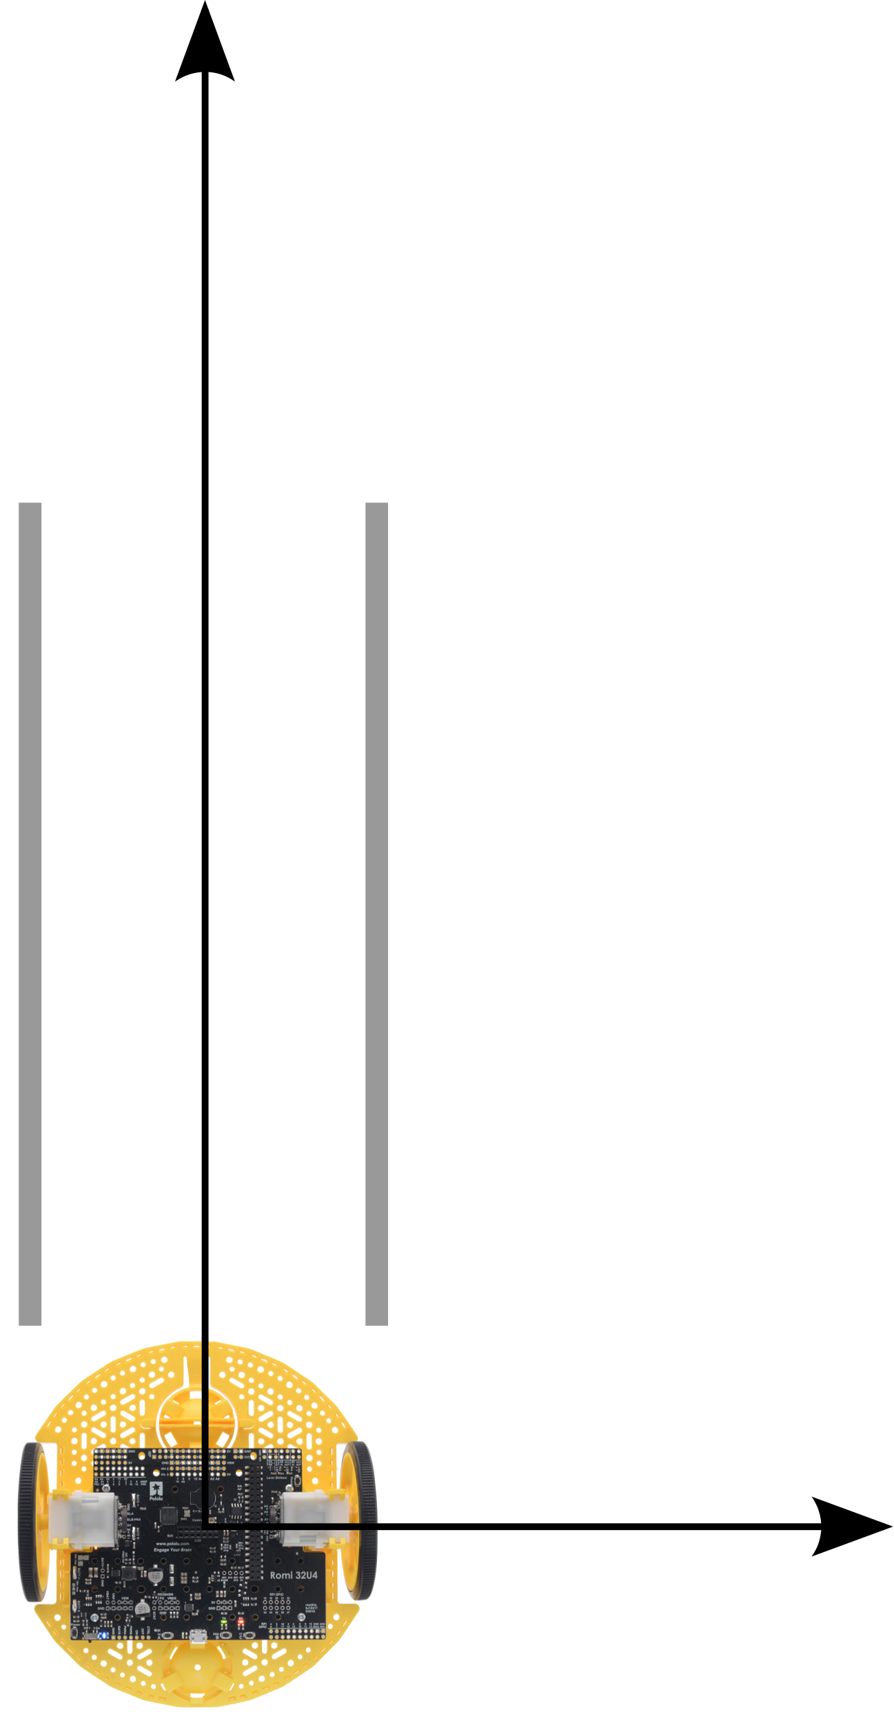
4023 counts, X = 603.45mm?
Notes:
What would happen if one wheel were to rotate slightly faster than the other?

Slide 27
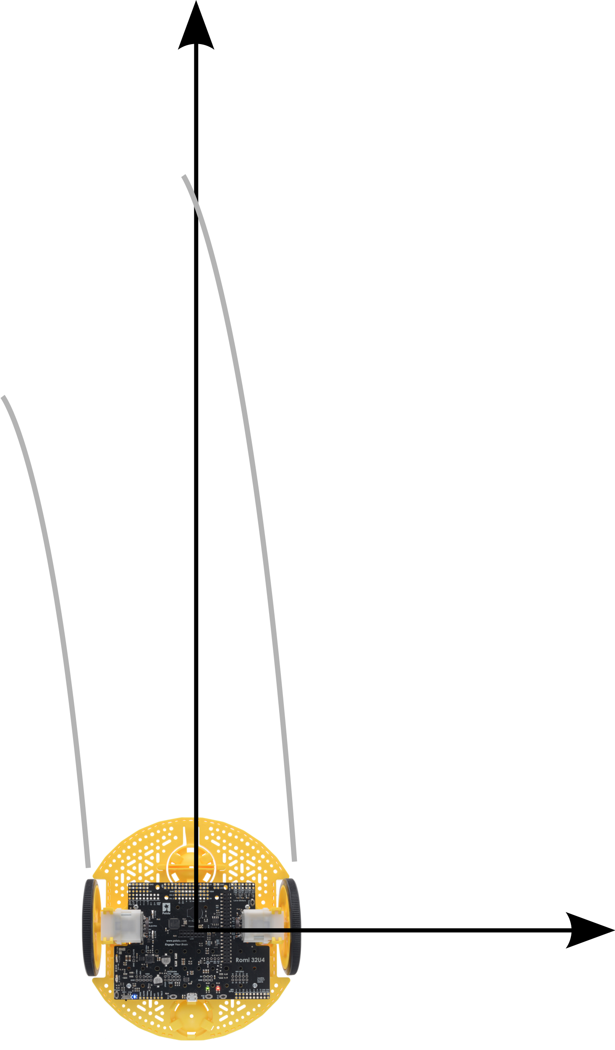
4023 counts
3800 counts

Slide 28
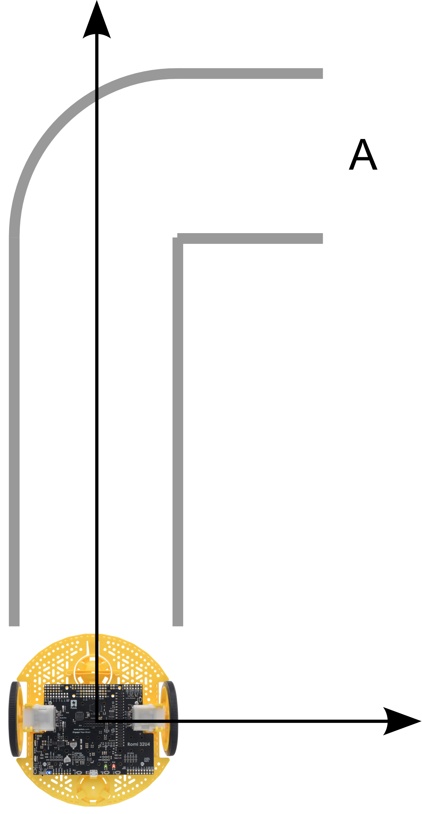
5200 counts
1
3000 counts

Slide 29
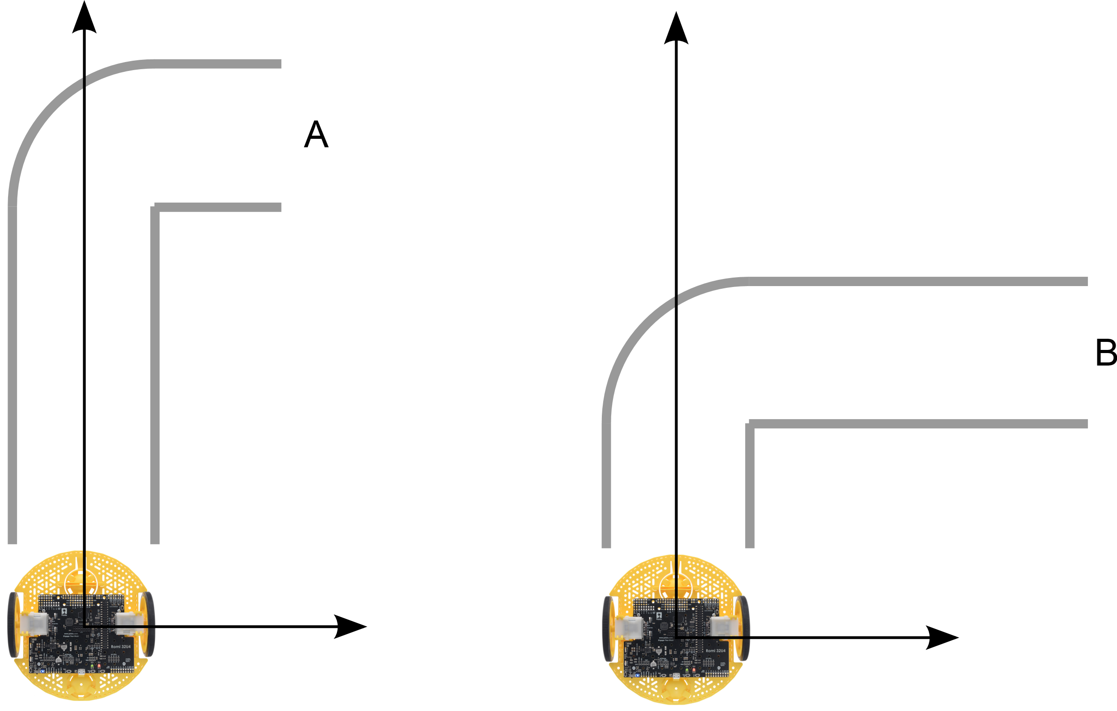
5200 counts
1
3000 counts
5200 counts
2
3000 counts
Notes:
With a mobile robot, there is no direct position measurement.
Position measurements must be integrated over time.

Slide 30
Local Reference Frame / Global Reference Frame
Y_{R}
Y_{R}
X_{R}
X_{R}

Slide 31
Local Reference Frame
Y_{R}
Wheel Separation
l
X_{R}
P
Our Global Reference
Frame will track point
P
Angular Velocity, Wheel Radius
Φ, r

Slide 32
Y_{R’}
Y_{I}
Local (robot)
Reference
Frame
Global (inertial)
Reference
Frame
θ_{R’}
X_{R’}
Integrate at all time steps:
contributions X_{R’}, Y_{R’}, θ_{R’} transformed to Global Reference
X_{I}

Slide 33
This Lecture
Kinematic Update
Encoder Resolution
Encoders and Distance
Coordinate Systems
Wheel Contributions
Transforming to Global Reference
Kinematic Model -> Kinematic Update
An Exception (advanced)

Slide 34
Wheel Contributions

Slide 35
Y_{R}
X_{R}
P
Angular Velocity, Wheel Radius
Φ, r

Slide 36
Y_{I}
Y_{R}
X_{R}
P
Angular Velocity, Wheel Radius
Φ, r
X_{I}

Slide 37
Y_{R}
X_{R}
P
Angular Velocity, Wheel Radius
Φ, r

Slide 38
More Complex Platforms
Y_{R}
X_{R}
P

Slide 39
Holonomic Mobile Robot:
https://www.youtube.com/watch?v=QNbblMEUm44
Holonomic Conveyor Belt:
https://www.youtube.com/watch?v=XAokGOEjAFs

Slide 40
Y_{R}
[
]
sin(α +ß ) -cos(α +ß ) (-l)cos(ß)
Maps to
X
Maps to
Y
Maps to
θ
ß
l
α
X_{R}
P
v

Slide 41
Y_{R}
[
]
sin(α +ß ) -cos(α +ß ) (-l)cos(ß)
Maps to
X
Maps to
Y
Maps to
θ
ß
l
α
X_{R}
P

Slide 42
Y_{R}
[
]
sin(α +ß ) -cos(α +ß ) (-l)cos(ß)
Maps to
X
Maps to
Y
Maps to
θ
ß
α = PI/2 (90º)
l
α
ß = 0
X_{R}
[
]
P
sin( PI/2 ) -cos(PI/2 ) (-l)cos(PI/2)

Slide 43
Y_{R}
[
]
sin(α +ß ) -cos(α +ß ) (-l)cos(ß)
Maps to
X
Maps to
Y
Maps to
θ
ß
α = PI/2 (90º)
l
α
ß = 0
X_{R}
[
]
P
sin( PI/2 ) -cos(PI/2 ) (-l)cos(PI/2)
[
]
1 0 0

Slide 44
( both wheels only contribute to X_{R} translation, θ_{R} rotation )

Slide 45
This Lecture
Kinematic Update
Encoder Resolution
Encoders and Distance
Coordinate Systems
Wheel Contributions
Transforming to Global Reference
Kinematic Model -> Kinematic Update
An Exception (advanced)

Slide 46
Transformation to Global Reference

Slide 47
Y_{I}
Y_{R}
Local (robot)
Reference
Frame
θ
Wheel Separation
l
X_{R}
Global (inertial)
Reference
Frame
Angular Velocity, Wheel Radius
Φ, r
X_{I}

Slide 48
Y_{I}
Y_{R}
Transformation Matrix:
cos(θ) -sin(θ) 0
sin(θ) cos(θ) 0
0 0 1
Wheel Separation
l
X_{R}
Angular Velocity, Wheel Radius
Φ, r
X_{I}

Slide 49
Y_{I}
Y_{R}
Local (robot)
Reference
Frame
Travel is always along X_{R}
X_{R}
P
X_{I}

Slide 50
Y_{R}
Y_{I}
Local (robot)
Reference
Frame
Travel is always along X_{R}
X_{R}
P
X_{I}

Slide 51
Y_{R}
Y_{I}
X_{R}
Local (robot)
Reference
Frame
Travel is always along X_{R}
P
X_{I}

Slide 52
Y_{R}
Y_{I}
Local (robot)
Reference
Frame
Rotation is approximated by X_{R} combined with a Theta component.
X_{R}
P
θ_{R’}
X_{I}

Slide 53
Y_{R}
Y_{I}
θ_{R’}
t = 3
θ_{R’}
X_{R}
P
θ_{R’}
t = 2
Smaller timesteps, better approximation
θ_{R’}
t = 1
X_{I}

Slide 54
Y_{R}
Y_{I}
Local (robot)
Reference
Frame
Global
Reference
Frame
X_{R}
Integrate at all time steps:
contributions X_{R}, Y_{R}, θ_{R} transformed to Global Reference
X_{I}

Slide 55
Local Reference
Movement
Transformation Matrix:
X_{R’}
Y_{R’}
θ_{R’}
cos(θ) -sin(θ) 0
sin(θ) cos(θ) 0
0 0 1

Slide 56
Local Reference
Movement, timestep
Transformation Matrix:
(X)
(Y)
(θ)
X_{R’}
Y_{R’}
θ_{R’}
cos(θ) -sin(θ) 0
sin(θ) cos(θ) 0
0 0 1

Slide 57
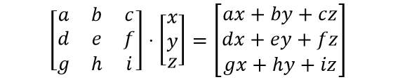
Local Reference
Movement, timestep
Transformation Matrix:
X_{R’}
Y_{R’}
θ_{R’}
cos(θ_{I}) -sin(θ_{I}) 0
sin(θ_{I}) cos(θ_{I}) 0
0 0 1
Multiplied out:
X_{I’} = ( X_{R’} * cos(θ_{I}) ) + ( Y_{R’} * -sin(θ_{I}) ) + (θ_{I} * 0 )
Y_{I’} = ( X_{R’} * sin(θ_{I}) ) + ( Y_{R’} * cos(θ_{I}) ) + (θ_{I’} * 0 )
θ_{I’} = ( X_{R’} * 0 ) + ( Y_{R’} * 0 ) + (θ_{I} * 1 )
Movement in Global Reference at timestep

Slide 58
Local Reference
Movement, timestep
Transformation Matrix:
X_{R’}
Y_{R’}
θ_{R’}
cos(θ_{I}) -sin(θ_{I}) 0
sin(θ_{I}) cos(θ_{I}) 0
0 0 1
X_{I’} = ( X_{R’} * cos(θ_{I}) ) + ( Y_{R’} * -sin(θ_{I}) ) + (θ_{I} * 0 )
Y_{I’} = ( X_{R’} * sin(θ_{I}) ) + ( Y_{R’} * cos(θ_{I}) ) + (θ_{I’} * 0 )
θ_{I’} = ( X_{R’} * 0 ) + ( Y_{R’} * 0 ) + (θ_{R’} * 1 )

Slide 59
Local Reference
Movement, timestep
Transformation Matrix:
X_{R’}
Y_{R’}
θ_{R’}
cos(θ_{I}) -sin(θ_{I}) 0
sin(θ_{I}) cos(θ_{I}) 0
0 0 1
Contribution
At timestep:
X_{I’} = ( X_{R’} * cos(θ_{I}) )
Y_{I’} = ( X_{R’} * sin(θ_{I}) )
θ_{I’} = θ_{R’}
Integrate to
Global:
X_{I} +=
Y_{I} +=
θ_{I} +=
X_{I’}
Y_{I’}
θ_{I’}

Slide 60
Y_{R}
Y_{I}
Local (robot)
Reference
Frame
Global
Reference
Frame
X_{R}
X_{I’} = ( X_{R’} * cos(θ_{I}) )
Y_{I’} = ( X_{R’} * sin(θ_{I}) )
θ_{I’} = θ_{R’}
At timestep:
We need to know X_{R’ and} θ_{R’} from a model of the robot body and wheels.
X_{I}

Slide 61
This Lecture
Kinematic Update
Encoder Resolution
Encoders and Distance
Coordinate Systems
Wheel Contributions
Transforming to Global Reference
Kinematic Model -> Kinematic Update
An Exception (advanced)

Slide 62
Kinematic Model

Slide 63
V_{left}
V_{right}
V_{left} = V_{right}

Slide 64
Therefore,
Kinematic model:
Given:
X_{right} = (Φ_{right} r )/ 2
V_{left}
X_{left} = (Φ_{left} r )/ 2
(Φ_{l} r ) + (Φ_{r} r )
X_{R’}
2
V_{right}

Slide 65
Therefore,
Kinematic model:
Given:
X_{right} = (Φ_{right} r )/ 2
V_{left}
X_{left} = (Φ_{left} r )/ 2
(Φ_{l} r ) + (Φ_{r} r )
X_{R’}
2
Y_{R’}
0
V_{right}

Slide 66
Therefore,
Kinematic model:
Given:
X_{right} = (Φ_{right} r )/ 2
V_{left}
X_{left} = (Φ_{left} r )/ 2
(Φ_{l} r ) + (Φ_{r} r )
X_{R’}
2
Y_{R’}
0
θ_{R’}
?
V_{right}

Slide 67
Instantaneous Centre of Curvature (ICC)
V_{l}
ICC
V_{r}
V_{l} = 0 V_{r} > 0

Slide 68
Instantaneous Centre of Curvature (ICC)
r_{ICC}
X_{R’} contribution of wheel
With unknown θ
ICC
V_{l} = 0 V_{r} > 0

Slide 69
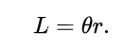
Instantaneous Centre of Curvature (ICC)
The wheel travels an arc length of a circle within a timestep
r_{ICC}
θ
From Wikipedia, Arc length L =

Slide 70
Instantaneous Centre of Curvature (ICC)
2 l
X_{R’} from right wheel, or otherwise (Φ_{r} r )
θ
From Wikipedia, Arc length L =

Slide 71
Instantaneous Centre of Curvature (ICC)
2 l
X_{R’} from right wheel, or otherwise (Φ_{r} r )
θ
From Wikipedia, Arc length L =
Re-arranged for θ:
θ = L / r

Slide 72
Instantaneous Centre of Curvature (ICC)
2 l
X_{R’} from right wheel, or otherwise (Φ_{r} r )
θ_{r'}
ICC
p
From Wikipedia, Arc length L =
Re-arranged for θ:
θ = L / r
Substitute our terms:
θ_{r’} = (Φ_{r} r ) / 2l

Slide 73
Therefore,
Kinematic model:
(Φ_{l} r ) + (Φ_{r} r )
X_{R’}
2
Y_{R’}
0
(Φ_{l} r ) - (Φ_{r} r )
θ_{R’}
2l

Slide 74
Recall: Local/Global Transformation:
X_{R’}
Y_{R’}
θ_{R’}
cos(θ) -sin(θ) 0
sin(θ) cos(θ) 0
0 0 1
X_{I’} = ( X_{R’} * cos(θ_{R’}) )
Y_{I’} = ( X_{R’} * sin(θ_{R’}) )
θ_{I’} = θ_{R’}
At timestep:
Integrate to
Global:
X_{I} +=
Y_{I} +=
θ_{I} +=
X_{I’}
Y_{I’}
θ_{I’}

Slide 75
Kinematic Update:
At timestep:
X_{I’} = ( X_{R’} * cos(θ_{I}) )
Y_{I’} = ( X_{R’} * sin(θ_{I}) )
θ_{I’} = θ_{R’}
( (Φ_{l} r ) + (Φ_{r} r )
* cos(θ_{R})
X_{I} +=
2
( (Φ_{l} r ) + (Φ_{r} r )
r = radius of wheel
l = wheel distance from centre of Romi
Φ = angular velocity
Y_{I} +=
* sin(θ_{R})
2
(Φ_{l} r ) - (Φ_{r} r )
θ_{I} +=
2l

Slide 76
This Lecture
Kinematic Update
Encoder Resolution
Encoders and Distance
Coordinate Systems
Wheel Contributions
Transforming to Global Reference
Kinematic Model -> Kinematic Update
An Exception (advanced)

Slide 77
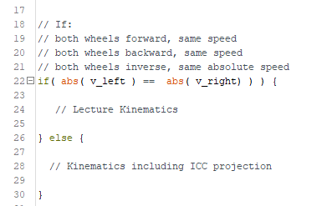
An Exception (advanced):

Slide 78
(vr + vl)
(vl - vr )
r_{ICC} = l *
r_{ICC}
V_{l}
V_{r}
ICC
V_{l} < V_{r}

Slide 79
This Lecture
Kinematic Update
Encoder Resolution
Encoders and Distance
Coordinate Systems
Wheel Contributions
Transforming to Global Reference
Kinematic Model -> Kinematic Update
An Exception (advanced)

Slide 80
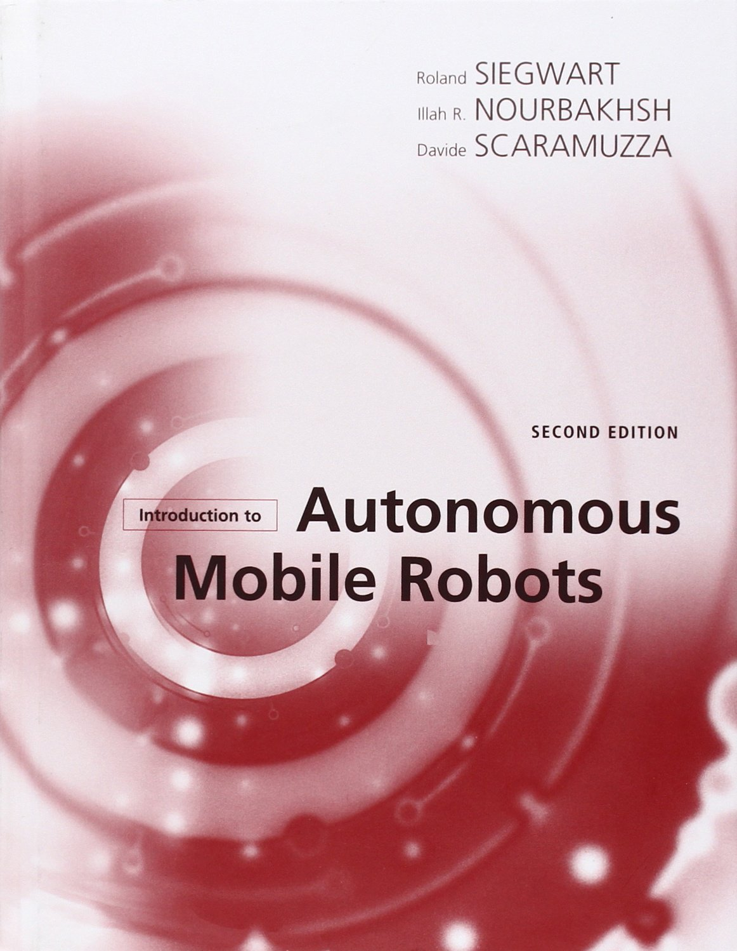
Introduction to Autonomous Mobile Robots (Intelligent Robotics & Autonomous Agents) (Intelligent Robotics and Autonomous Agents series)
Publisher: MIT Press; second edition edition (18 Mar. 2011)
Language: English
ISBN-10: 0262015358
ISBN-13: 978-0262015356

